Slide 1
I.V.A MESSAGE SECURITY
STEGANOGRAPHY USING PYTHON

Slide 2
CONTENT OF THE PROJECT
Introduction to the Steganography
Difference between Steganography and Cryptography
Objectives of the project
Description of the project
Implementation of the project
Work Division Of The Project among Group Members
Conclusion

Slide 3

INTRODUCTION TO STEGANOGRAPHY
Steganography is the art and science of embedding secret messages in a cover message in such a way that no one, apart from the sender and intended recipient, suspects the existence of the message.
In Steganography the useless bits are actually replaced by the useful bits in order to hide the required file into any of the files or data mentioned above.
It plays a vital role in cybersecurity by allowing the legitimate users or peers to send the data in a way which is highly secured so that it could be protected from the hacker or malicious users who are intended to harm or abuse the system.
The applications used for Steganography hides the bits of the required file into another file in a manner so that the original file doesn’t lose its characteristics

Slide 4
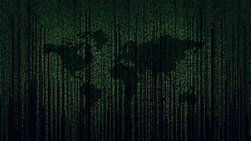
DIFFERENCE BETWEEN STEGANOGRAPHY & CRYPTOGRAPHY
STEGANOGRAPHY
CRYPTOGRAPHY
The meaning of the steganography is “covered or hidden writing”.
Steganography is an attempt to achieve secure and undetectable communication.
The steganography can be employed on any medium such as text, audio, video and image
In steganography, the main structure of the message is not changed.
The meaning of cryptography signifies “secret writing”.
Cryptography intends to make the message readable for only the target recipient but not by others through obtaining a disguised form of message.
The cryptography is implemented only on the text file.
In cryptography, a change is imposed on the secret message before transferring it over the network.

Slide 5
OBJECTIVE OF THE PROJECT
The aim of this project is to:
Input of the hidden message from the user that user wants to keep hidden using a security key and perform operations like encryption and decryption.
Encrypt the message from the user into either a file or an image.
Decrypt the message from either the file or image in which the message is hidden and show it to the user as output.

Slide 6
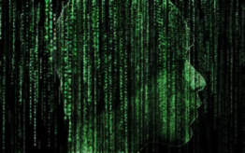
DESCRIPTION OF THE PROJECT
Libraries & Modules Used in Python
Subprocess Library
Pillow Library
OpenCV Library
OS Library
NumPy Library
Tkinter Library

Slide 7
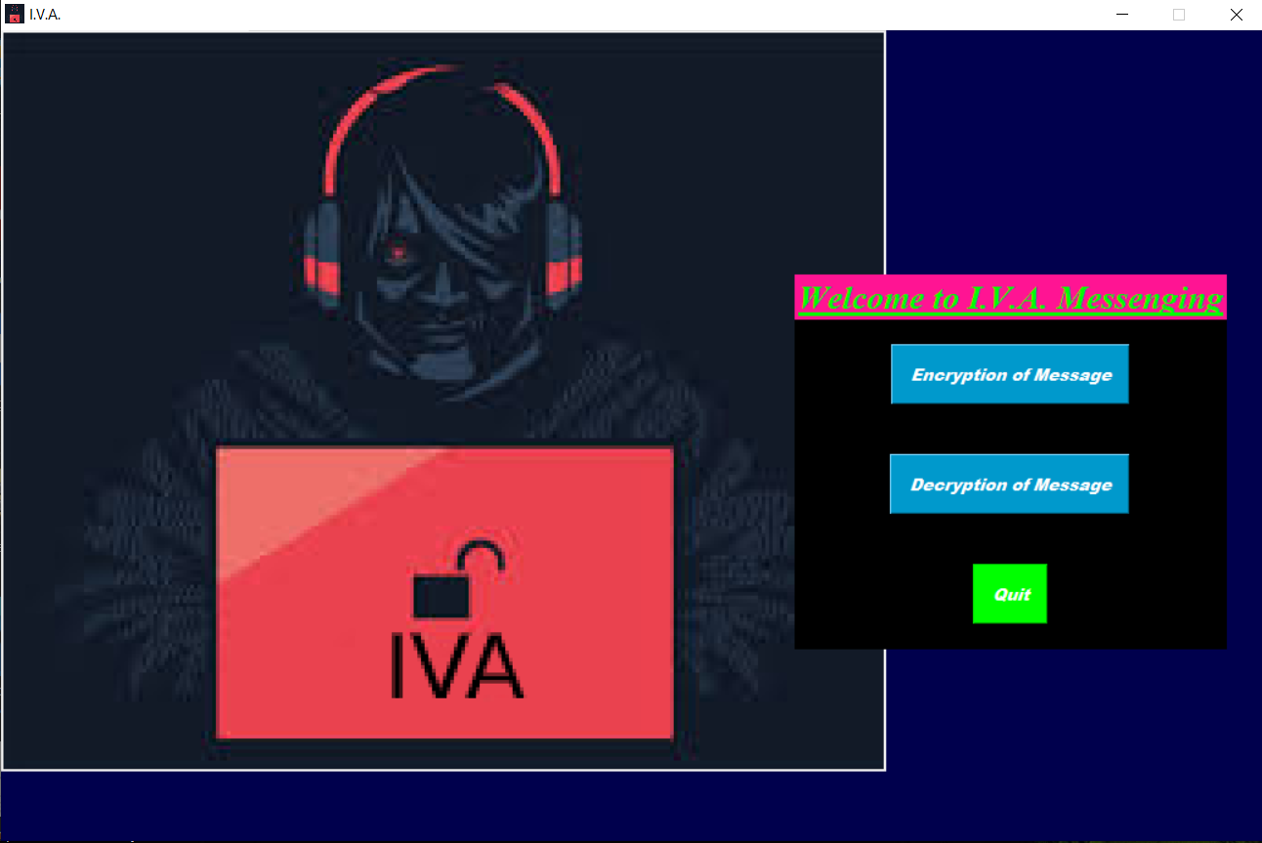
IMPLEMENTATION OF THE PROJECT
Homepage
It is our homepage. From here you can redirect to encryption or decryption page respective of your click.
The Background is our logo.
You can only off the application by quit button.
This page is not resizable.

Slide 8
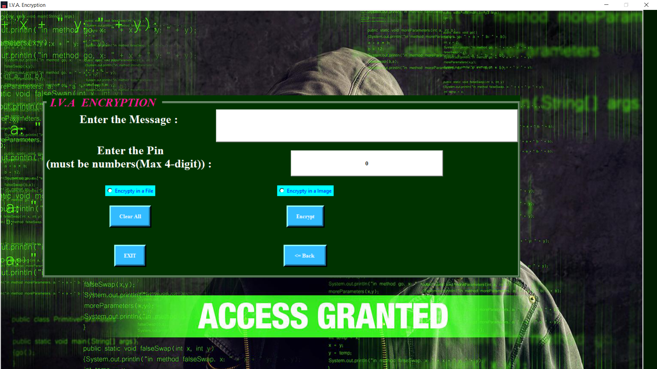
Encryption Page
It is our Encryption Page.
It accepts Message (Max 255 characters), Pin (4-Digit No)
Select the Format
It has Clear, Exit , Encrypt and Back button.
It covers all the Exceptions like empty fields, No Format selected, etc.
If All data is right according to check then a message box show success and in case the format is image , Encrypted Image is also shown.

Slide 9
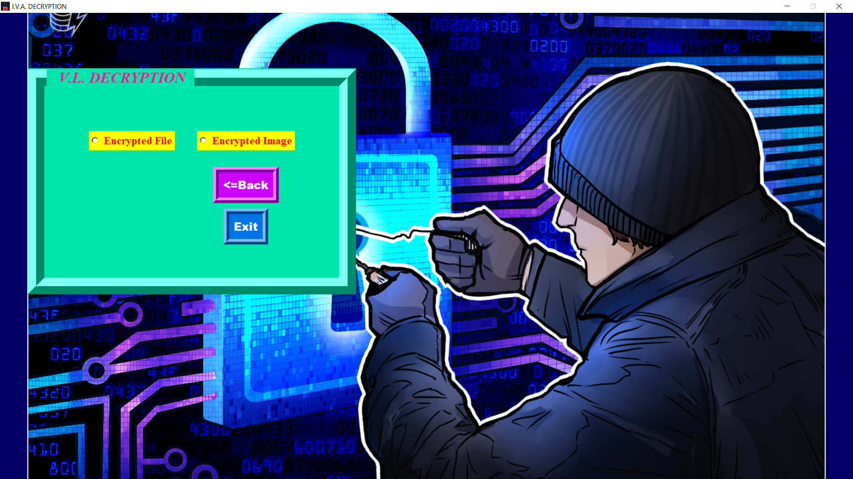
Decryption Page (Initial)
It is our Decryption Page (Initially).
It asks User to select the choice i.e. he/she has which encrypted file format as it is selected it shows the below GUI.
It has Back and Exit Button, Back Go back to Homepage.

Slide 10
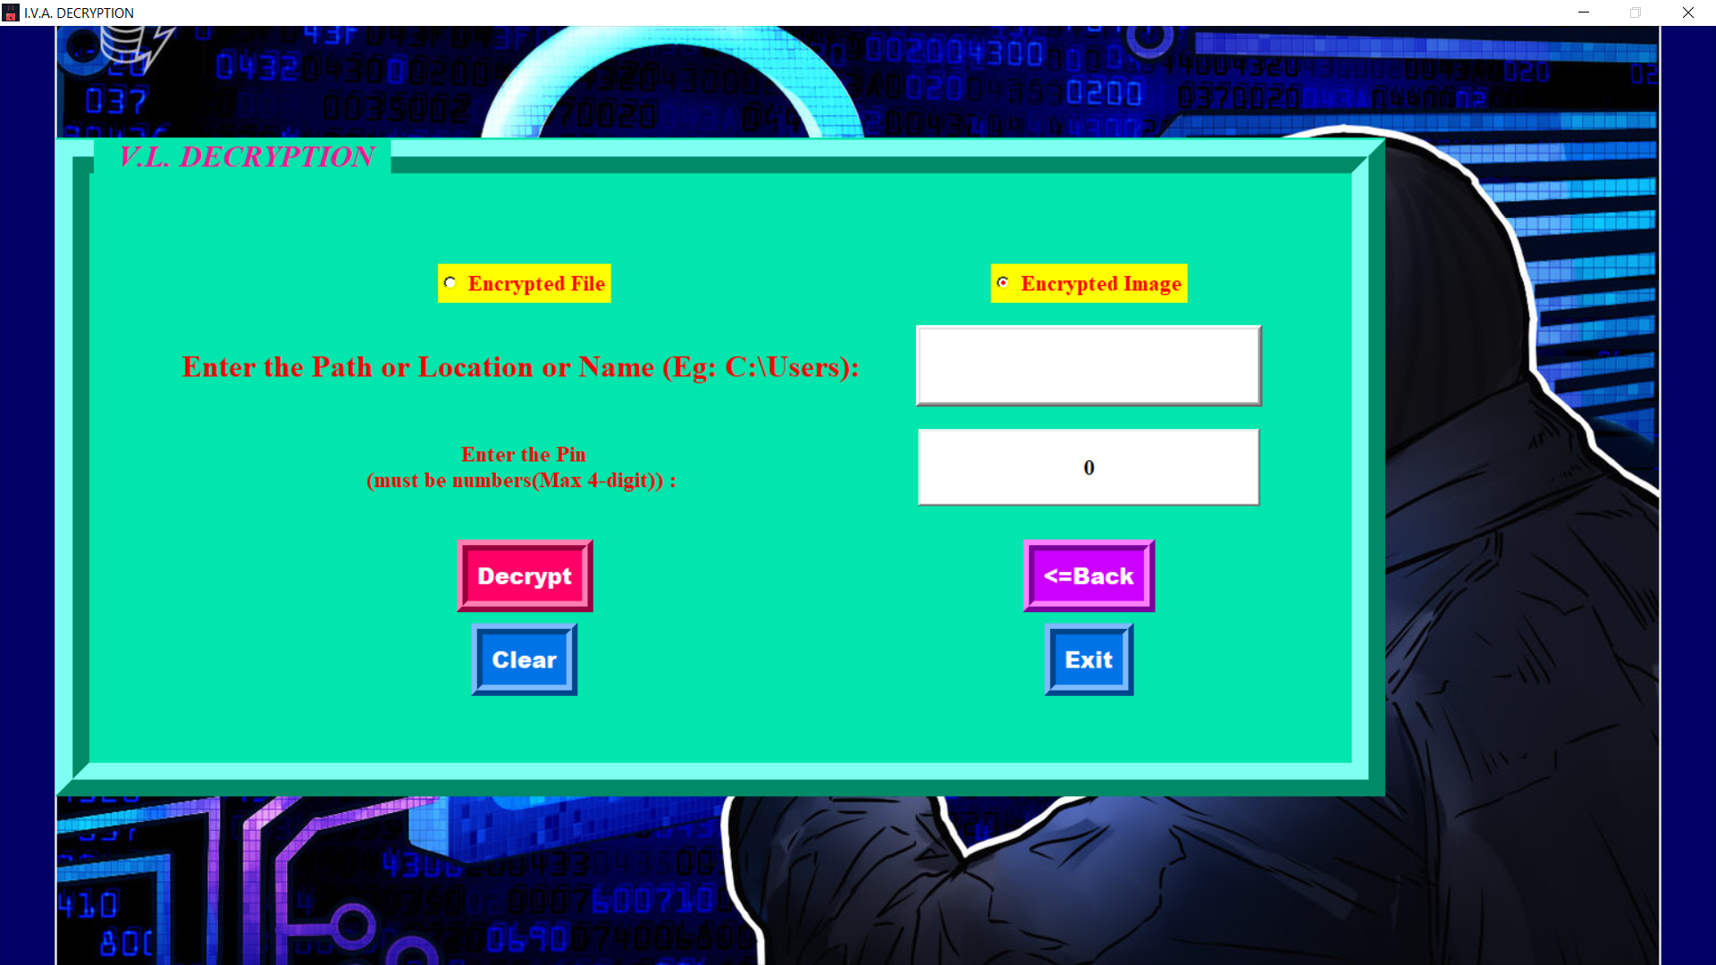
Decryption Page (Final)
It is our Decryption Page (Final).
It asks User to select the choice i.e. he/she has which encrypted file format as it is selected it shows the below GUI.
It has Back and Exit Button, Back Go back to Decryption Page (Initial).
It accepts path of Image/File, a 4-dgit pin of numbers.
It handles exception when Decrypt Button like Validate Pin , Path given ,File Formats and finally if all the data given is correct like pin then it shows the message in message box.
But, if Pin is incorrect then
1. Back and Exit is Disabled.
2. You have 2 attempts it is shown in warning message box.
3. Even in last attempt you give correct pin then the destroyer stops
4.But even in last attempt pin is wrong then the encrypted file is deleted either it is a image or pck file from Hard Disk. And then it show a error message box show removing files.
Clear Button Clear all the text fields.

Slide 11
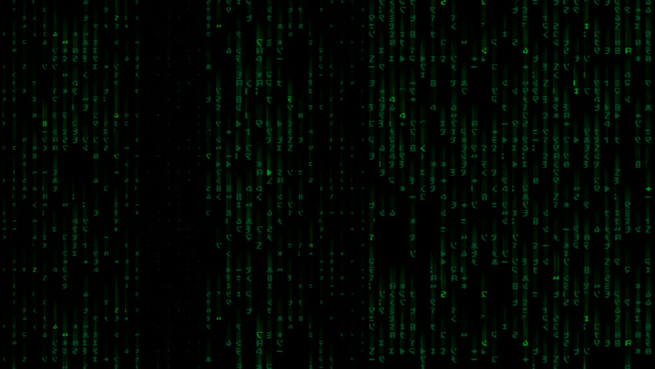
WORK DIVISION AMONG FROUP MEMBERS
VIKRAM SHARMA
Made translation module to convert the string into relevant code.
ISHIKA AGGARWAL
Design and Construct GUI.
KUMAR ARMAN SIKRIWAL
Made the decryption module along with all reverse layers.
Made encryption modules along with layers.
Final Checking and bug fixing in every part and Brain Storming on Encryption ways and Decryption.
Manages the Project and allocate works.
Made the final report and PowerPoint presentation.
Testing of Layers of Encryption.
Designing GUI.
Made the installation modules for the user.

Slide 12
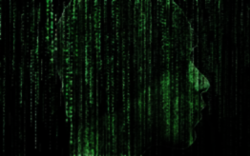
CONCLUSION
Steganography is the science deals with how communication can be disguised while cryptography is the science of transforming the content of the communication and making it obscure. It also implies the difference between breaking the system, the steganography is defeated if the presence of steganography is disclosed, whereas in cryptography the attacker must not be able to read the secret message otherwise the system is broken. The security of the steganography depends on the secrecy of the data encoding system.

Slide 13

A presentation by : Ishika Aggarwal – 23
Kumar Armaan Sikriwal – 47 Vikram Sharma - 51

